Slide 1
NVIDIA Financial Analysis
Vincent Piper

Slide 2
Objective
The objective of this project is to conduct a comprehensive analysis aimed at elucidating the factors contributing to NVIDIA's prominent position within the GPU processing industry. This will be achieved through an examination of their cash flow statement, juxtaposed with comparative evaluations of other key players in the GPU processing sector. Additionally, the project will entail a market analysis, focusing on NVIDIA's market share dynamics and strategic partnerships to provide a comprehensive understanding of their leadership status within the industry

Slide 3
Hypothesis
Through a detailed financial analysis of NVIDIA's cash flow statement and a comparative assessment with other prominent entities in the GPU processing domain, it is hypothesized that NVIDIA's leadership in GPU processing is attributable to a combination of robust financial performance, strategic market positioning, and effective utilization of external sponsorships and partnerships.

Slide 4
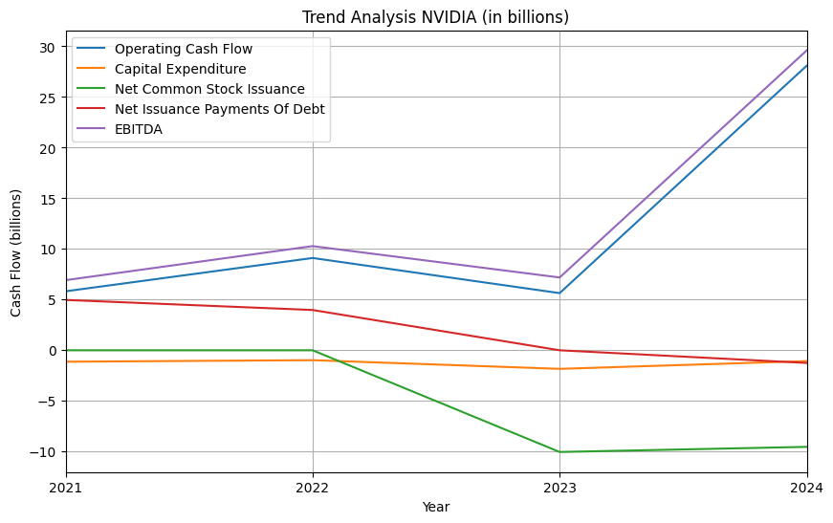
Trend Analysis (NVIDIA)
Operating cash flow and EBITDA are both increasing steadily within the last year from ~$10 billion to $30 billion. This positive increase over the past year is symbolic of all NVIDIA GPUs adaptability in the field of machine learning and AI; this is due to the introduction of AI products into the public domain, which began in 2023

Slide 5
Trend Analysis (NVIDIA)
Since 2022, Net Common Stock Issuance has increased and Net Issuance Payments of Debt have witnessed steady declines. These are both, in general, positive for NVIDIA as selling more common stock can enhance NVIDIA’s financial flexibility by diversifying its funding sources and reducing reliance on debt financing. By relying less on external finances, NVIDIA is leveraging its internal resources to bolster its cash flow.

Slide 6
Trend Analysis (NVIDIA)
Capital expenditure is flatlining at approximately $1 to $2 billion for NVIDIA. Given the company's control over its own supply chain and manufacturing processes, as well as its ownership of companies that supply it with stock, the necessity for external investments is relatively low. Consequently, this value should raise very few, if any, concerns.

Slide 7
Competitor 1: AMD

Slide 8
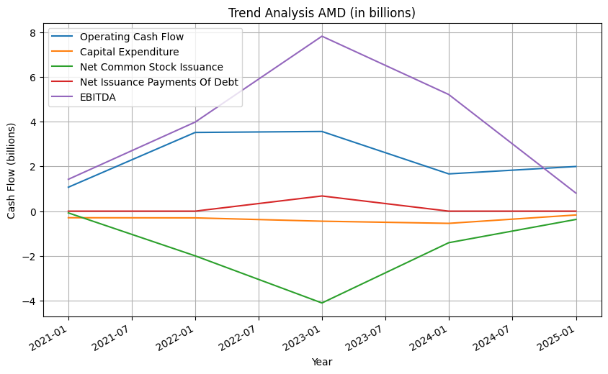
Trend Analysis (AMD)
As of March 14, 2024, AMD has not yet made its 10-K form accessible to the public. Consequently, the absence of this critical financial disclosure introduces a degree of uncertainty into the analysis, potentially skewing the data for the year 2024. To mitigate this limitation, a linear regression function was employed to estimate the values for each relevant column for the year 2024.

Slide 9
Trend Analysis (AMD)
The operating cash flow exhibited a modest decline in 2023, with a projected marginal increase anticipated for 2024. Conversely, EBITDA experienced a notable downturn in 2023 and is forecasted to undergo a further, more pronounced decline in 2024. Drawing insights from the analysis of the 10-K filings and predicted financial data in these domains, such trends are indicative of the output associated with underperforming GPUs and a business model facing challenges.

Slide 10
Trend Analysis (AMD)
Since 2022, AMD has observed a decrease in Net Common Stock Issuance alongside a slight decline in Net Issuance Payments of Debt. Such trends may signify a potential limitation in AMD's capacity to actively pursue growth opportunities, potentially impeding its long-term market positioning. Notably, the level of capital expenditure has remained stagnant, hovering around $0-$2 billion. Given AMD's comparatively lower market share relative to NVIDIA, this outcome warrants attention, as a higher level of capital expenditure is typically favored for companies seeking expansion

Slide 11
Competitor 2: Intel

Slide 12
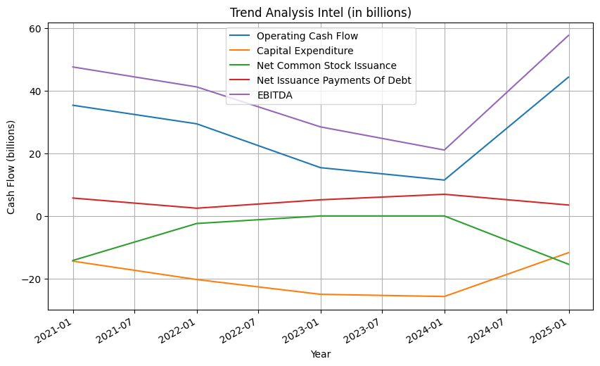
Trend Analysis (Intel)
As of March 14, 2024, Intel has not yet made its 10-K form accessible to the public. Consequently, the absence of this critical financial disclosure introduces a degree of uncertainty into the analysis, potentially skewing the data for the year 2024. To mitigate this limitation, a linear regression function was employed to estimate the values for each relevant column for the year 2024.

Slide 13
Trend Analysis (Intel)
The operating cash flow and EBITDA are decreasing in the year 2023 but predicted to increase for 2024. These results share the same analysis as NVIDIA’s results for these respective areas. These results are indicative of well maintained and up-to-date GPUs as well as a firm business model.

Slide 14
Trend Analysis (Intel)
For the data pre-2024 that is accessible to the public, Intel has no stock issuance, very little debt issuance and a very high CapEx. This is indicative of a company of whom is not taking significant debt, not reliant on external equity financing and consistently investing in future growth. Post-2024 data shows there being stock issuance present and a decrease in capital expenditure, therefore opposing their respective statements made previously

Slide 15
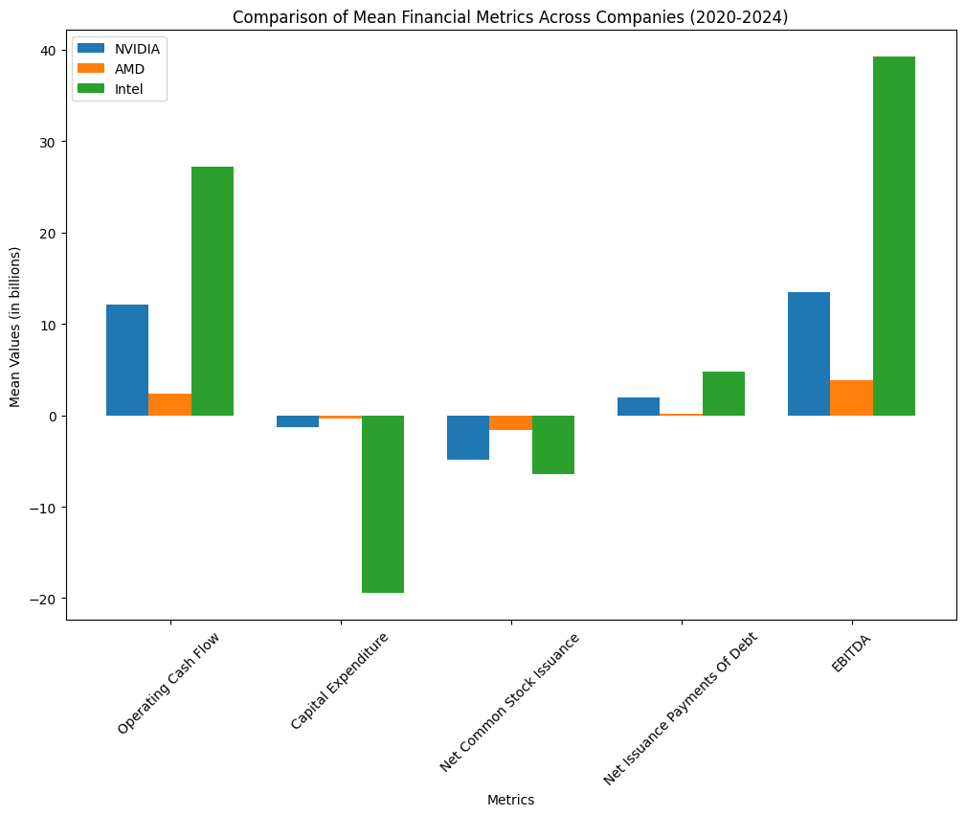
The graph shown displays a comparison of the mean of each of these metrics for each company. From a new angle, we can see that intel is most certainly the most active of the three GPU giants.
From the years 2020-2024, Intel is projected to invest approximately $35 billion into CapEx and stock issuance and gain an approximate $70 billion in operating cash flow, debt issuance and EBITDA, doubling the value of their investments in these respective fields
Nvidia is projected to invest approximately $7 billion in CapEx and debt issuance and gain an approximate $30 billion in operating cash flow, debt issuance and EBITDA, more than tripling their investments in these respective fields.

Slide 16
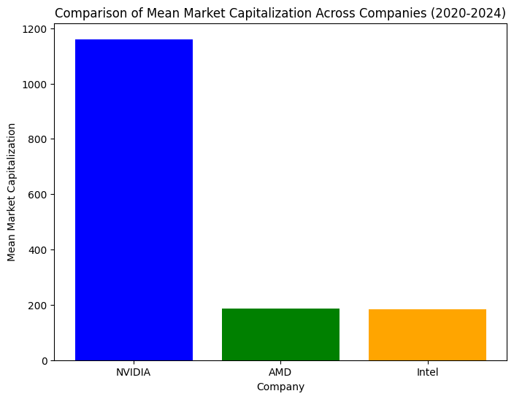
Here is a comparison of each company’s mean market capitalization from 2020-2024
What we can conclude from this plot and the previous plot is that NVIDIA not only has more than quintupled the mean market share of its competitors over the past 4 years, it is also the most primed to continue its growth, as its ratio of investment to profit was the highest amongst itself and its contenders.

